Slide 1
ENIAC’S PRICING STRATEGY
Does revenue grow with an increase in discounts?
Jorge, Liane, Sai, Yanish
Notes:
Relationship between Discount and Revenue - we have been looking into the data. When we say revenue we mean the money that came in from selling our products.

Slide 2
Span of Database: 01/01/2017 - 14/03/2018 Completed Orders only
Overview of Products and Revenue
Products | sold | Revenue | % of Total Revenue
Discounted | 55,670 | € 7.2 million | 92%
Non-Discounted | 4341 | € 575,081 | 8%
Total | 60,011 | € 7.8 million | 100 %

Slide 3
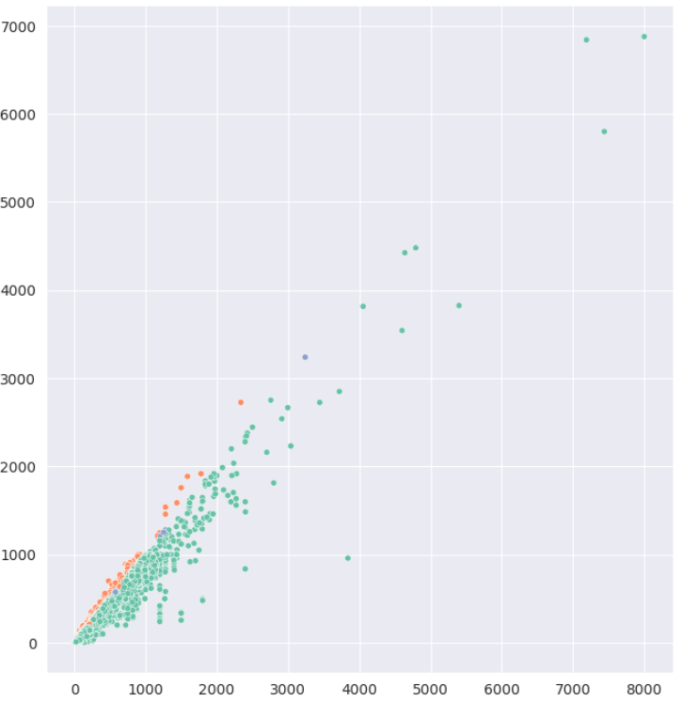

Overview of Discounts
1,5 million € total discount
19.5 % of Total Revenue
26 € Average Discount

Slide 4
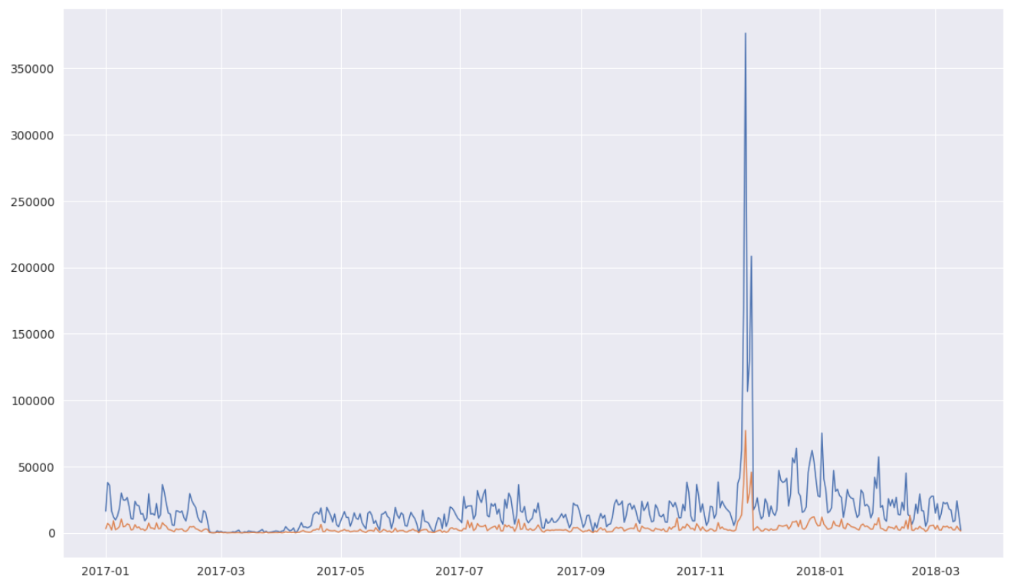
Analysis of Revenue and Discount over time
Peak in revenue in November
Black Friday and Christmas Sales
Discount not always directly affecting revenue
revenue
discount
Notes:
Before diving deeper into the discount, you will see here an overview of revenue and discount over the past 15 month. There is a huge peak in November, which seems to be the Black Friday and Christmas Sales. We can also see that while revenue and discount kind of move along each other, the discount is not always directly affecting revenue

Slide 5
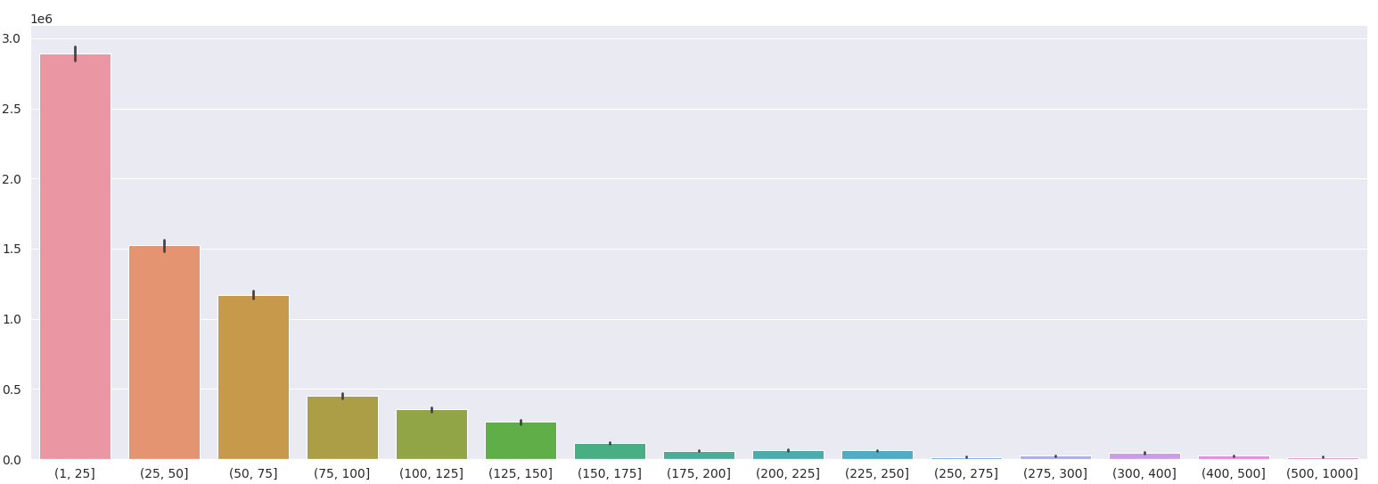
Most revenue is made in the 1 - 25 € discount-segment
Notes:
Let’s look closer at the discounts that we offer.
Are these few huge orders actually driving our revenue? Or is the bulk of smaller discounts that drive our revenue?
Here we clearly see, that most revenue is actually made in the 1-25€ discount segment.. And that the revenue exceeding 100€ is not the major part of our revenue.

Slide 6
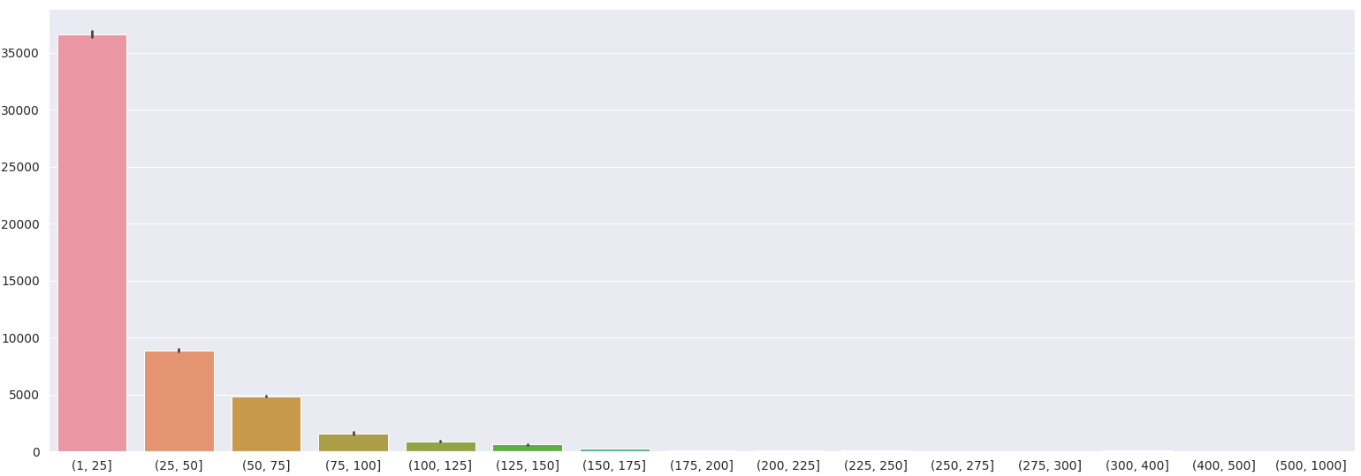
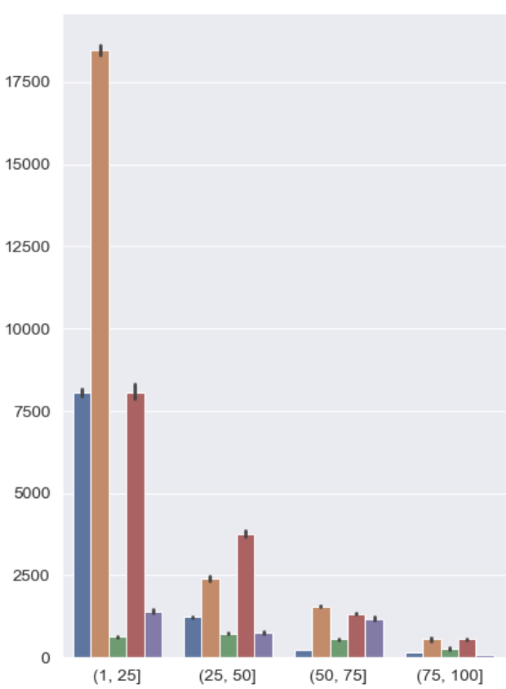
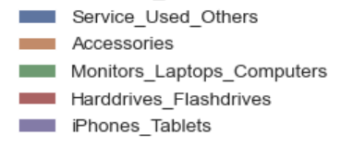
Huge number of products in the 1-25€ segment
… which is driven be selling Accessories
Notes:
Here we looked at the same discount-segments, but only up to 100 € discount. On the y-axis we see the number of products. We have a huge number of products in the fist segment (1-25 €) and this is mainly driven by accessories.

Slide 7
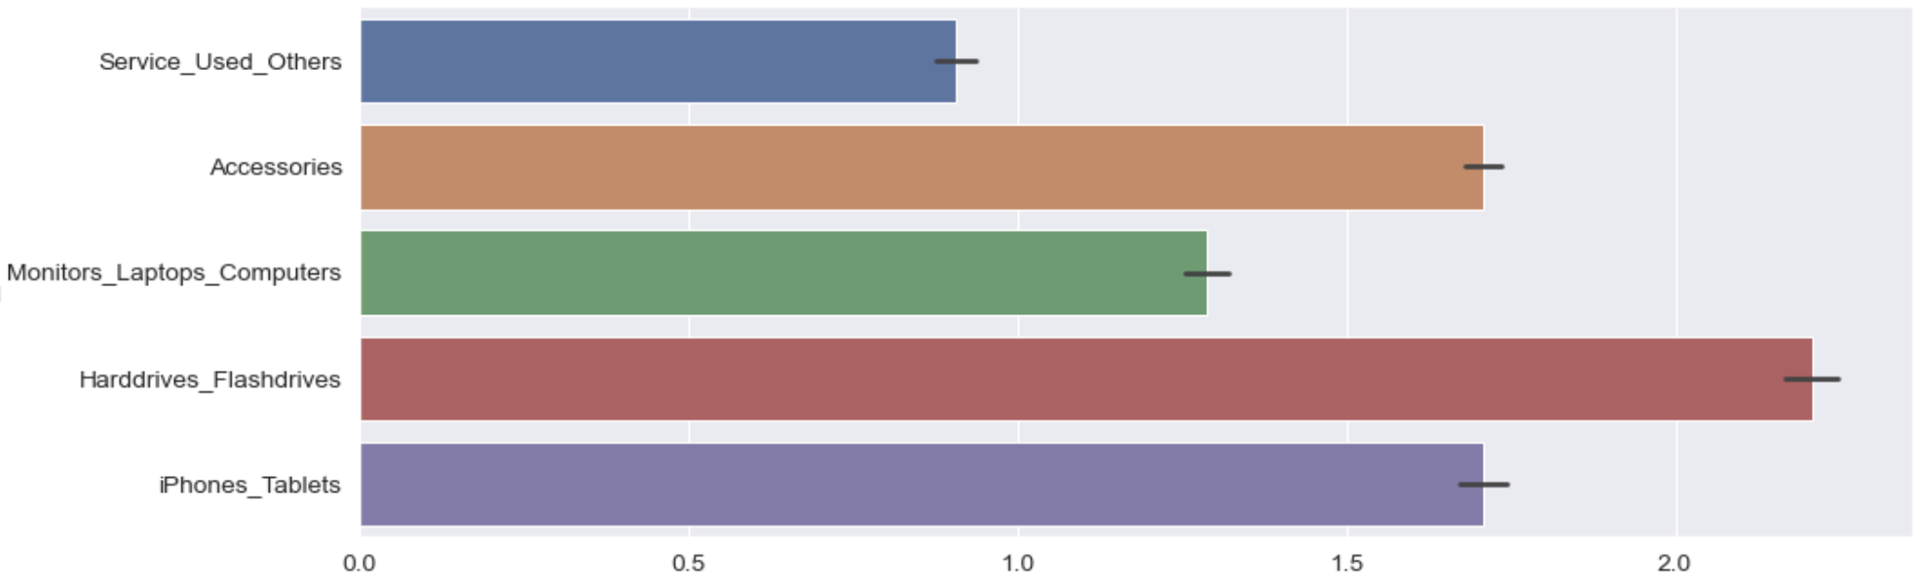
Revenue of different categories
Average Revenue

Slide 8
Revenue and Discounts are not evenly distributed
…across different product categories:
average Revenue &
average Discount:
Harddrive/Flashdrive
iPhones/Tablets
average Revenue &
average Discount:
Accessories
average Revenue &
average Discount:
Service_Used_Other
Notes:
To understand, correlation of category wise revenue with its discount.. We found R and D are not evenly distributed.. With this I meant is… HF and IT generate more revenue but offer below average D. and ACC gerate above avg revenue but also offers above average discount. Interestingly, SUO generates below avg R even after offering above avg D.

Slide 9
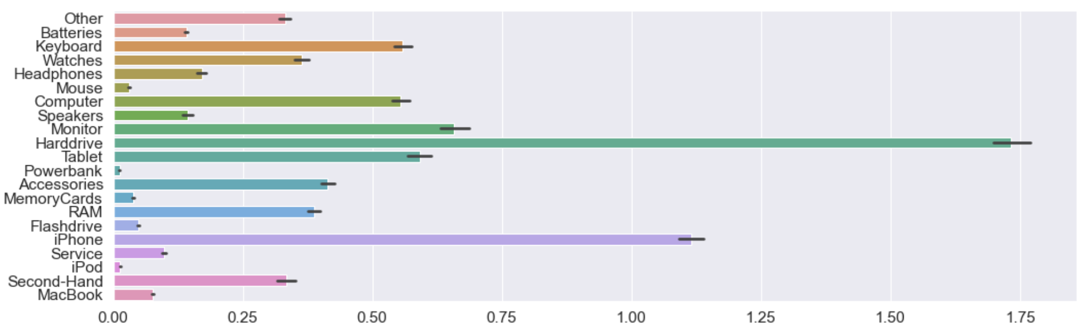
Revenue of different subcategories
Average Revenue
Notes:
All subcategories with above average revenue we have looked into their average discounts.
And clustered the ones with below average discount and the ones with above average discount (from this group - all of the ones that have a revenue beyond this line)
And then we looked at the ones below average revenue to see where we give above average discount. (and that’s the last cluster)
To understand this analysis, we segregated categories into 21 sub categories.. HD is the highest, iphone is 2nd highest… Powerbank, headphone, ipod, FD, are one of the lowest revenue generating categories.
And now Jorge will present the results.

Slide 10
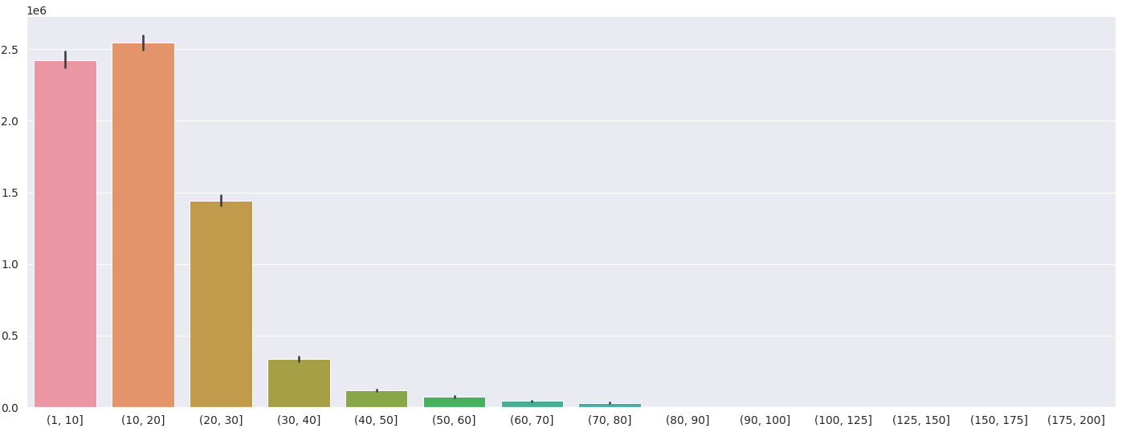
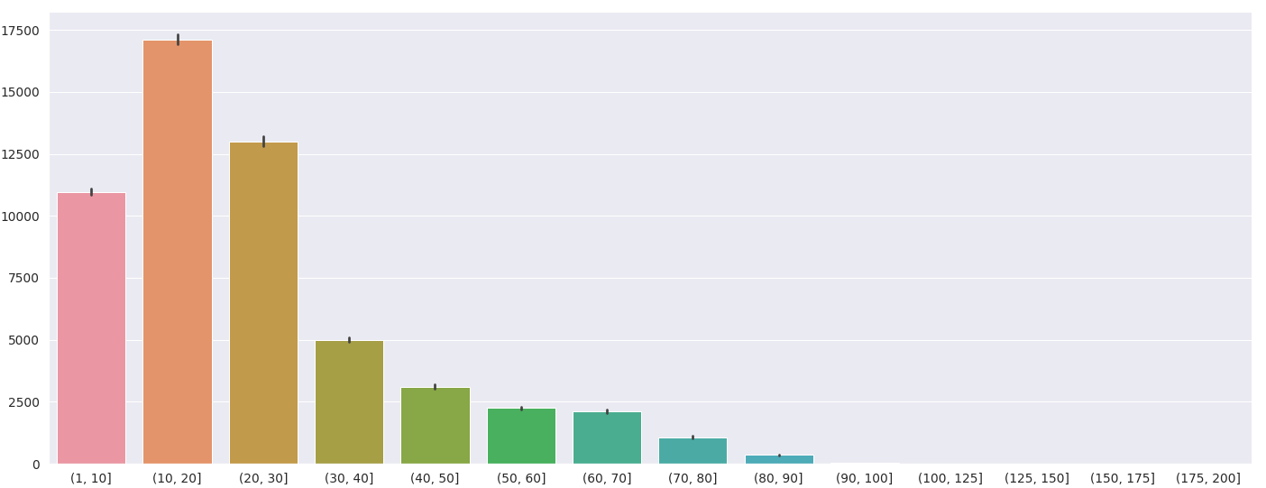
RECAP: Discount > 30% is accounting for only 9% of revenue
… even though there are more products sold
9%
22%
Notes:
To recap

Slide 11

Classification of Subcategories
Our Recommendation:
Average Revenue &
Average Discount:
Harddrive
iPhone
Monitor
Tablet
Computer
RAM
Watches
Average Revenue &
Average Discount:
Keyboard
Accessories
Second-Hand
Average Revenue &
Average Discount:
Powerbank (56%)
Flashdrive (30%)
Headphones (27%)
…
→Try decreasing discounts to see if revenue increases
→Try not to give huge discounts
Notes:
In the first cluster we find all subcategories with above average revenue and below average discount:
For example the Harddrive, iPhone, Monitor, Tablet, Computer. Here we do not see a need to change.
But, as we have seen, there are also subcategories with above revenue discount which are the Keyboard, Accessories, and Second-Hand products. Here - especially for the first two of them - we could try to decrease the discounts to see if it impacts the revenue.
In the third cluster, we have the subcategories with below average discount, where we give an above average discount. We suggest not to give huge discounts for these subcategories.

Slide 12
Thank you!

Slide 16
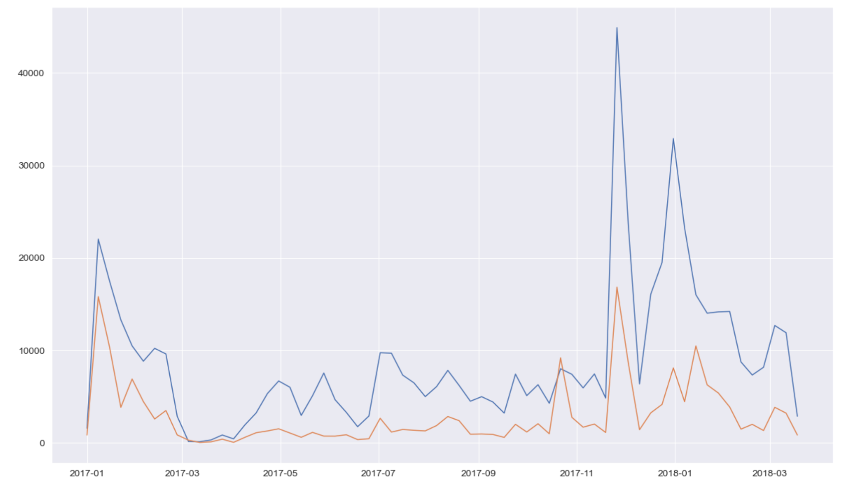
Is revenue driven by discount for keyboard?
Maybe we could make this chart for keyboards?

Slide 17
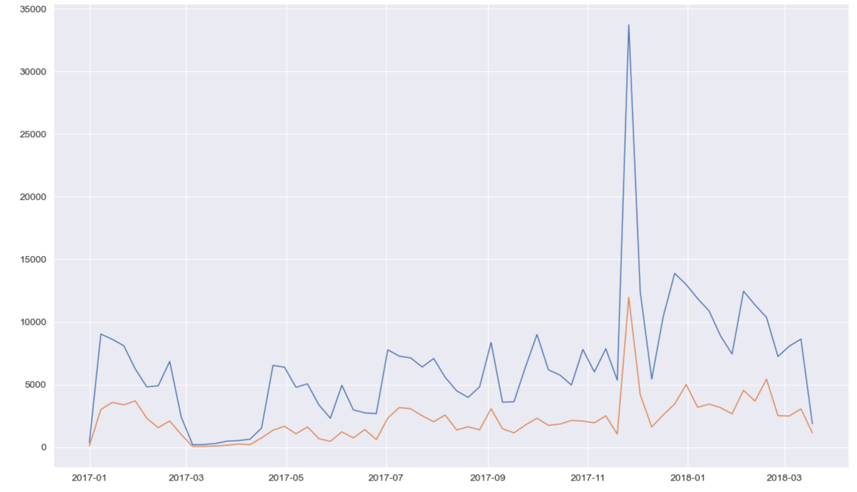
Is revenue driven by discount for accessory?

Slide 18
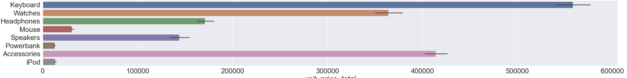

Slide 19
Is revenue driven by discount for second-hand?

Slide 20
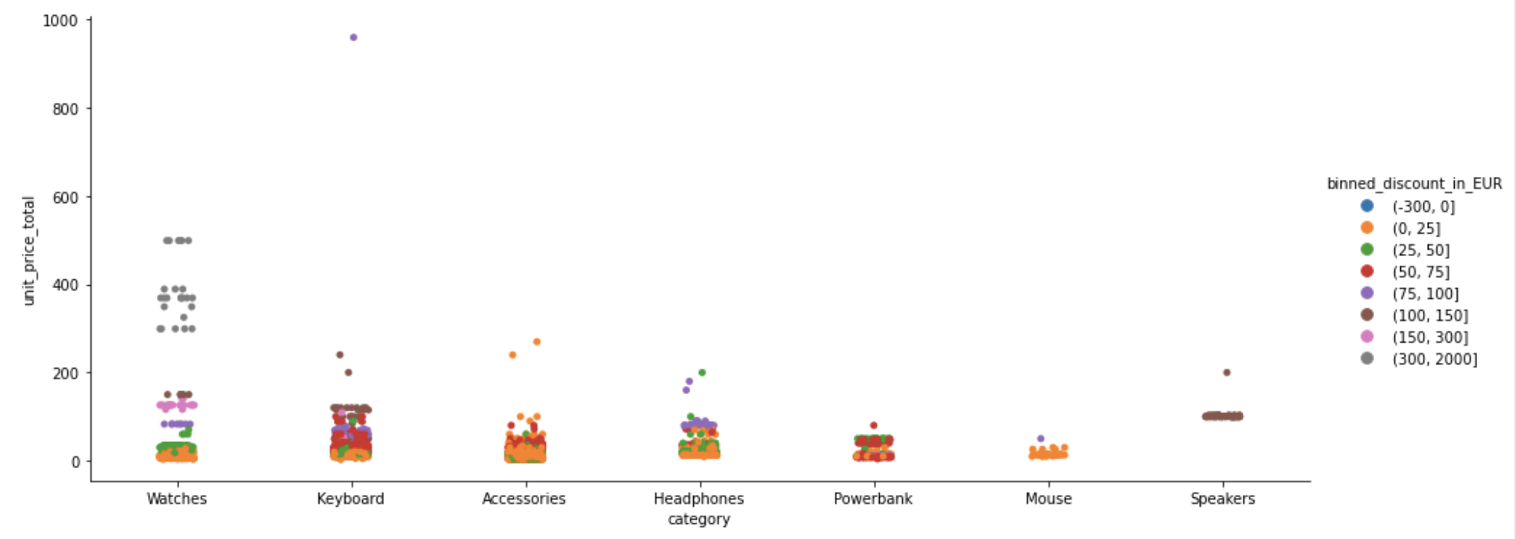
High value discounts per subcategory
Redo the graph
High value discounts (> 75 EUR) have been mainly found in the subcategories of Watches, Speakers, Keyboards and Headphones.

Slide 23
UNDERSTANDING “DISCOUNT AND REVENUE”
Why to or why not to give discount
Does revenue grow whenever there is an increase in discount…

Slide 27
Revenue and Discounts are not evenly distributed
Categories with
above average revenue and below average discount
- iPhones
above average revenue and above average discount
- Harddrives
below average revenue and above average discount
- Accessories
Notes:
Show the charts

Slide 28
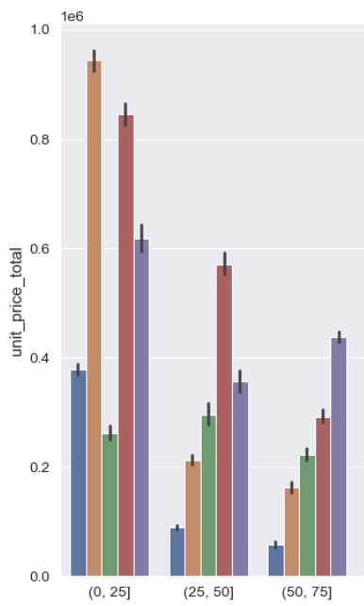
Revenue for discounts per category

Slide 29
Analysis of Discounts
“Extreme” discounts
Effect of discounts in different categories
Which products creating more revenue and their discounts (ideally, discount should be less ) ?
Harddrives
iPhones
Effect of discounts over time

Slide 30
Analysis of extreme discounts
Extreme Discounts exceeding 700 €
Are almost all due to refurbished iMacs

Slide 31
Analysis of products over-time
In Q4 2017 we had sales of 3,037,096.34 and a total number of products sold of 20,251.
* 2017 - Q4: (3,037,096.34, 20,251)
* 2017 - Q3: (1,366,908.1, 10,429)
* 2017 - Q2: ( 845,881.28, 6,725)
* 2017 - Q1: ( 961,560.19, 10,013)
And looking forward:
* 2018 - Q1: (1,605,758.49, 12,593)
Q1 is not yet finished and will be less than then 3 million of Q4 2017.
But it passed already 1 Million and is thus higher than all other quarters before.
-how do prices evolve in time compared with amount of sales of it, is there a correlation? especially for things like phones
-TIME: How seasonality and special dates (Christmas, Black Friday) affect sales. (can be shown by graph - already have it)
- Time question (not the same prices always)

Slide 32
Future Improvement of Data on Discounts
Huge Difference between Product prices and unit prices of iphone 7 and iphone 6 models (as these are launched in the year 2016-2017)
The product prices should be stored over time, to improve the calculation of discounts.
(TODO: Add a graph showing price differences)
Notes:
Cutting this slide and telling this point after the conclusion

Slide 33


Slide 34
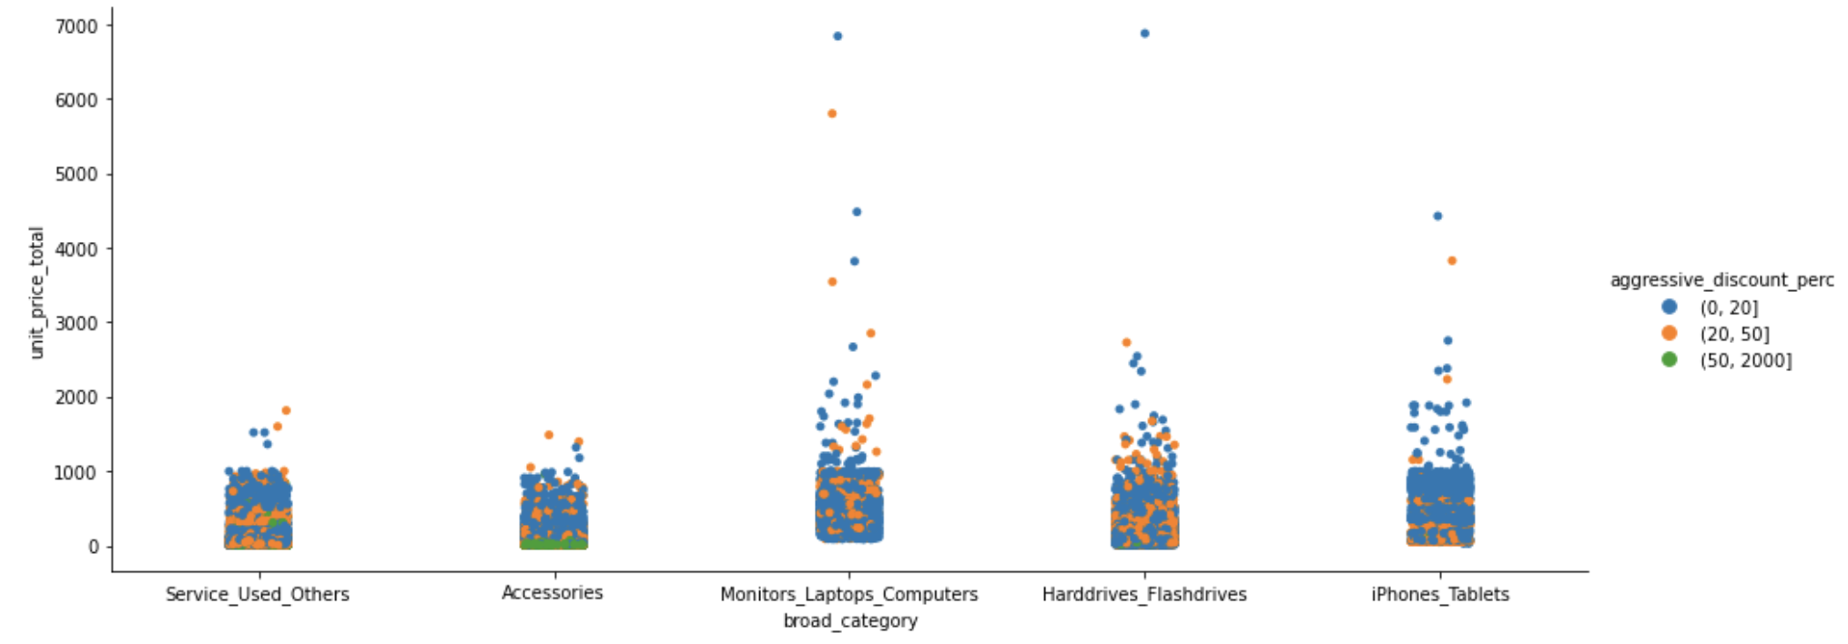
High Percentage Discounts per Category
Aggressive Discounts have been mainly given in the category ‘Accessories’

Slide 35
High value discounts per subcategory
High value discounts (> 75 EUR) have been mainly found in the subcategories of Watches, Speakers, Keyboards and Headphones.

Slide 36
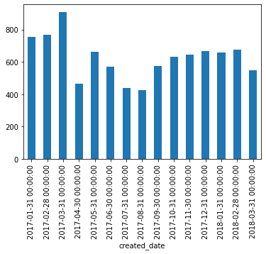
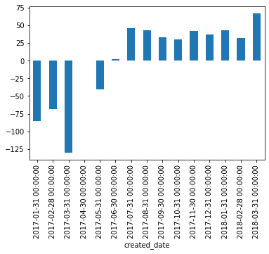
For iPhones the revenue is not related to discounts
Redo the graphics - lables

Slide 37
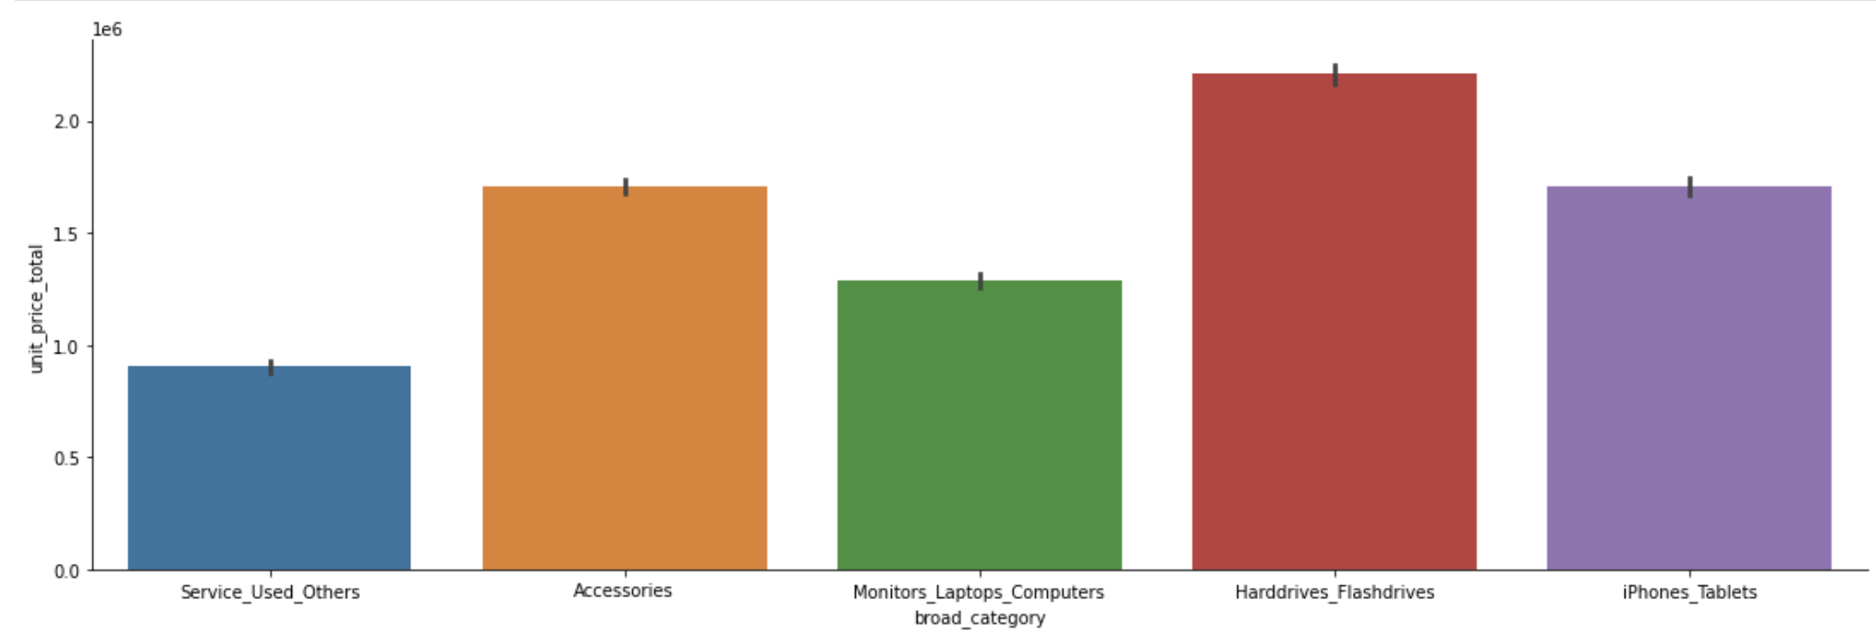
Analysis of Different Categories
- …
Notes:
What is the distribution of product prices across different categories.
- How many products and or categories are being discounted. (with the numbers)

Slide 38
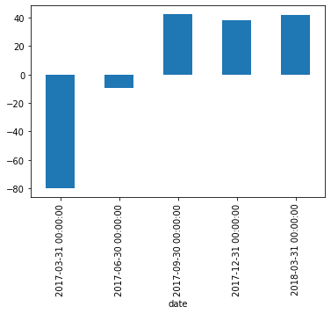
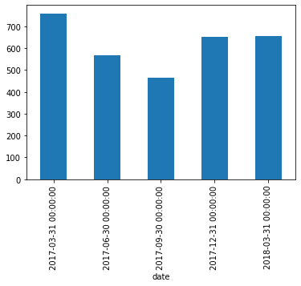

Slide 40
Classification of Subcategories
Our Recommendation:
Average Revenue &
Average Discount:
Harddrive
iPhone
Monitor
Tablet
Computer
RAM
Watches
Average Revenue &
Average Discount:
Keyboard
Accessories
Second-Hand
Average Revenue &
Average Discount:
Powerbank (56%)
Flashdrive (30%)
Headphones (27%)
…
→Try decreasing discounts to see if revenue increases
→Try not to give huge discounts
Notes:
In the first cluster we find all subcategories with above average revenue and below average discount:
For example the Harddrive, iPhone, Monitor, Tablet, Computer. Here we do not see a need to change.
But, as we have seen, there are also subcategories with above revenue discount which are the Keyboard, Accessories, and Second-Hand products. Here - especially for the first two of them - we could try to decrease the discounts to see if it impacts the revenue.
In the third cluster, we have the subcategories with below average discount, where we give an above average discount. We suggest not to give huge discounts for these subcategories.

